Slide 1
(Insert name here)
Noah Hallows

Slide 2
Identification of the problem
Due to the ubiquity of cameras in the modern world there has been an exponential increase in the number of photos and video taken
This poses a challenge to people who don’t want to have their photo publicly available
My solution is to make an automated system to identify and remove an individual’s face from photos

Slide 3
Software solution challengers
Selection of appropriate face recognition library
Performance
Effective and easy to use graphically user interface
Selection of appropriate system to edit matching images

Slide 4
Data structure

Slide 5
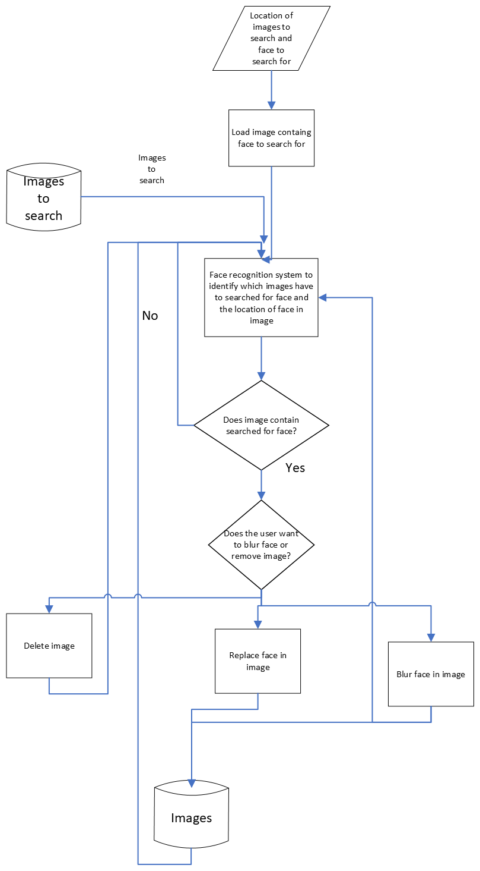
Program Logic
Several control structures were required to ensure this program functions correctly
A main loop is required to loop over all the images to be processed
Two if statements are required to evaluate if the image matches and what the program should do to matching faces
There are also multiple threads to ensure the program remains responsive

Slide 6
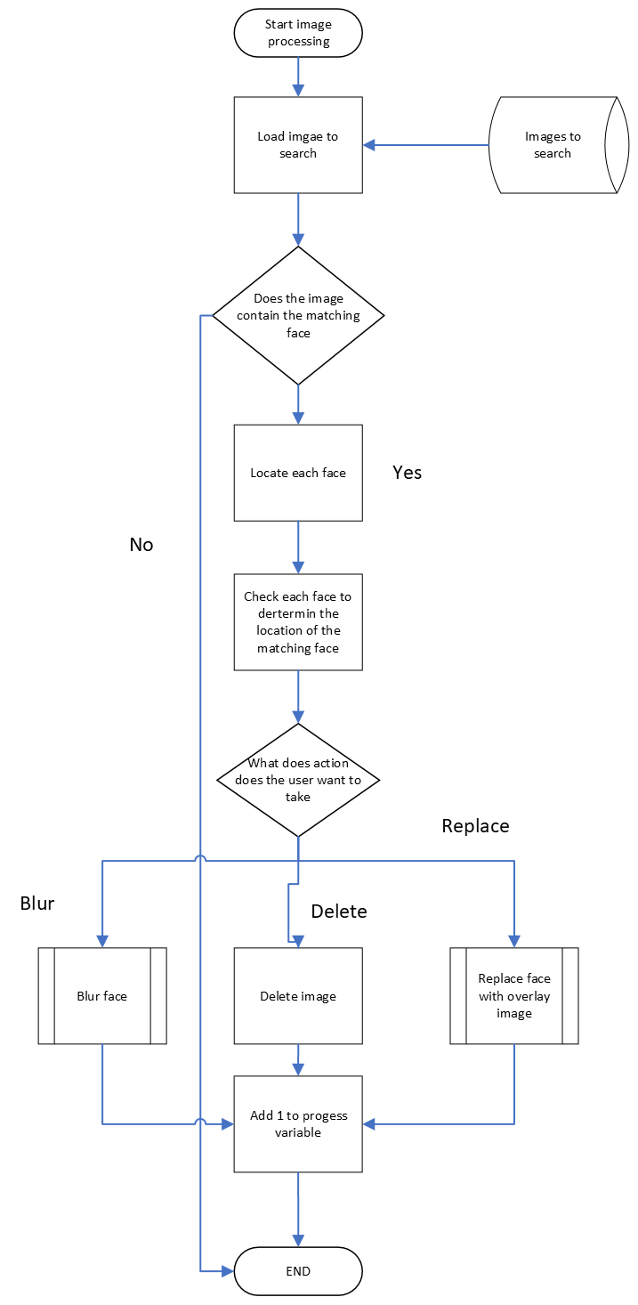
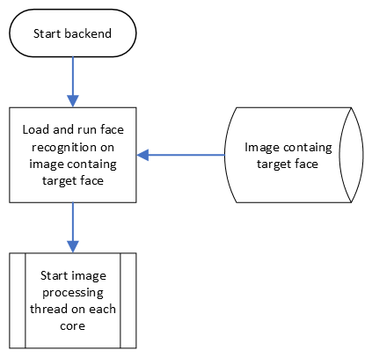
Backend logic
The backend is divided into several modules so the individual modules can be run on separate threads
Once the program locates the matching faces it calls a module selected by the user that act

Slide 7
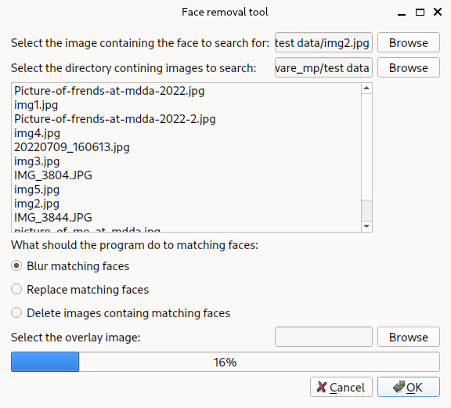
Frontend logic
The program uses string searching to extract to directory from the browse button
The progress bar is getting updated from a separate thread
The program runs the backend logic in a separate process so the ui remains responsive

Slide 8
Multithreading

Slide 9
UI example

